Slide 1
Chapter 8 Securitization and the Credit Crisis of 2007

Slide 2
Securitization
Traditionally banks have funded loans with deposits
Securitization is a way that loans can increase much faster than deposits

Slide 3
Asset Backed Security (Simplified)
Senior Tranche
Principal: $80 million
Return = LIBOR + 60bp
Asset 1
Asset 2
Asset 3

Asset n
Principal:
$100 million
SPV
Mezzanine Tranche
Principal:$15 million
Return = LIBOR+ 250bp
Equity Tranche
Principal: $5 million
Return =LIBOR+2,000bp

Slide 4
The Waterfall
Asset Cash Flows
Senior Tranche
Mezzanine Tranche
Equity Tranche

Slide 5
ABS CDOs or Mezz CDOs (Simplified)
The mezzanine tranche is repackaged with other mezzanine tranches
ABSs
Assets
Senior Tranche (80%)
AAA
ABS CDOs
Senior Tranche (65%)
AAA
Mezzanine Tranche (15%)
BBB
Mezzanine Tranche (25%) BBB
Equity Tranche (5%)
Not Rated
Equity Tranche (10%)

Slide 6
Losses to AAA Senior Tranche of ABS CDO (Table 8.1, page 189)
Losses on Subprime portfolios | Losses on Mezzanine Tranche of ABS | Losses on Equity Tranche of ABS CDO | Losses on Mezzanine Tranche of ABS CDO | Losses on Senior Tranche of ABS CDO
10% | 33.3% | 100% | 93.3% | 0%
13% | 53.3% | 100% | 100% | 28.2%
17% | 80.0% | 100% | 100% | 69.2%
20% | 100% | 100% | 100% | 100%

Slide 7
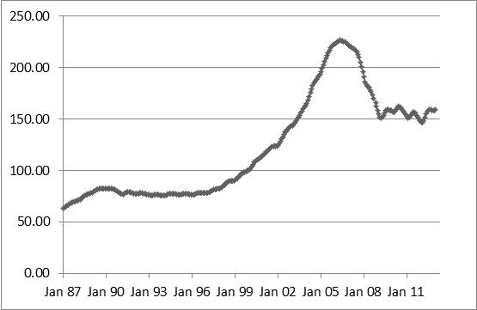
U.S. Real Estate Prices, 1987 to 2013: S&P/Case-Shiller Composite-10 Index

Slide 8
What happened…
Starting in 2000, mortgage originators in the US relaxed their lending standards and created large numbers of subprime first mortgages.
This, combined with very low interest rates, increased the demand for real estate and prices rose.
To continue to attract first time buyers and keep prices increasing they relaxed lending standards further
Features of the market: 100% mortgages, ARMs, teaser rates, NINJAs, liar loans, non-recourse borrowing
Mortgages were packaged in financial products and sold to investors

Slide 9
What happened...
Banks found it profitable to invest in the AAA rated tranches because the promised return was significantly higher than the cost of funds and capital requirements were low
In 2007 the bubble burst. Some borrowers could not afford their payments when the teaser rates ended. Others had negative equity and recognized that it was optimal for them to exercise their put options.
Foreclosures increased supply and caused U.S. real estate prices to fall. Products, created from the mortgages, that were previously thought to be safe began to be viewed as risky
There was a “flight to quality” and credit spreads increased to very high levels
Many banks incurred huge losses

Slide 10
What Many Market Participants Did Not Realize…
Default correlation goes up in stressed market conditions
Recovery rates are less in stressed market conditions
A tranche with a certain rating cannot be equated with a bond with the same rating. For example, the BBB tranches used to create ABS CDOs were typically about 1% wide and had “all or nothing” loss distributions (quite different from BBB bond)
This is quite different from the loss distribution for a BBB bond from a BBB bond

Slide 11
Regulatory Arbitrage
The regulatory capital banks were required to keep for the tranches created from mortgages was less than that for the mortgages themselves

Slide 12
Incentives
The crisis highlighted what are referred to as agency costs
Mortgage originators (Their prime interest was in in originating mortgages that could be securitized)
Valuers (They were under pressure to provide high valuations so that the loan-to-value ratios looked good)
Traders (They were focused on the next end-of year bonus and not worried about any longer term problems in the market)

Slide 13
The Aftermath…
A huge amount of new regulation (Basel II.5, Basel III, Dodd-Frank, etc). For example:
Banks required to hold more equity capital with the definition of equity capital being tightened
Banks required to satisfy liquidity ratios
CCPs and SEFs for OTC derivatives
Bonuses limited in Europe
Bonuses spread over several years
Proprietary trading restricted

